Slide 1
Unit 6
Electric Traction

Slide 2
Traction system
Electric traction means the locomotion in which the driving(or tractive) force is obtained from electric motors.
It is used in electric trains, tramcars, trolley buses and diesel electric vehicles, etc.
It has many advantages as compared to other non electrical system of tractions including steam traction.

Slide 3
Types of traction on the basis of power drive
Non Electrical Traction
Electrical Traction

Slide 4
Non Electrical Traction
Traction system which does not uses the electrical power to drive, are called Non Electrical Traction system.
There are various types of non electrical systems:
1. Steam Engine
2. Diesel Engine

Slide 5
Electrical Traction
Traction system which uses the electrical power to drive, are called Electrical Traction system.
There are 4 types of electrical tractions based of electrification system:
1. D.C. System
2. Single Phase A.C. System
3. Three Phase A.C. System
4. Composite System

Slide 6
D.C. System
D.C. system contains D.C. supply of rating 600V, 750V, 1500V, 3000V.
dc system uses the low voltage ,series wound D.C. Series Motor to drive the train.
dc motor is well suited to railroad traction, being simple to construct and easy to control.
Until the late 20th century it was universally employed in traction system.

Slide 7
Single Phase A.C. System
Alternating current system was used due to incapability of dc system i.e. high voltage. The higher voltage limit for the dc system was 3000 Volts.
With alternating current, especially with relatively high voltage over-head wire, fewer substations are required, and the lighter overhead current supply wire that can be used correspondingly reduces the weight of structure needed to support it to the further benefit of capital cost of electrification.
A.C. series motor is used due to high starting torque.
Substations are used in distance of 30-40 Km to maintain the voltage level along the track.
Voltage rating is 15-25 KV for this system.

Slide 8
Three Phase A.C. System
This system is used for high voltage ratings. In three phase system we can transmit high voltage level which is for efficient transmission is required.
This system uses 3 phase induction motor, 3 phase supply, 50-60 Hz supply.
voltage rating of motor is 3.3-3.5 KV.

Slide 9
Composite System
There are two types of composite systems:
single phase to dc system(used where voltage level is high for transmission and dc machine is used in the locomotive.)
single phase to 3 phase system(used where 3 phase machine is used in the locomotive and single phase track we have.)

Slide 10
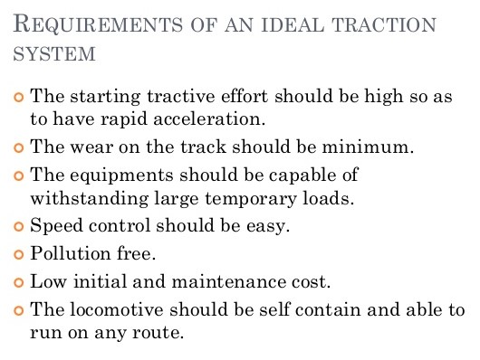

Slide 11
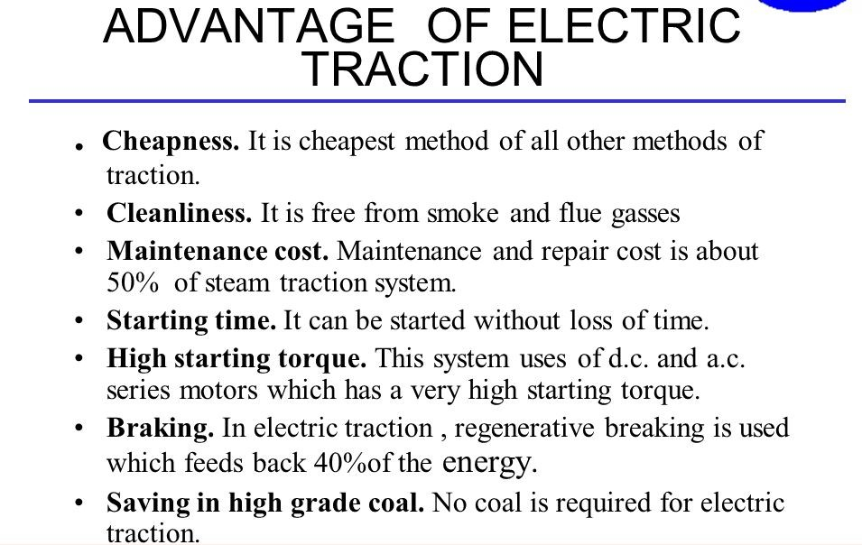

Slide 12
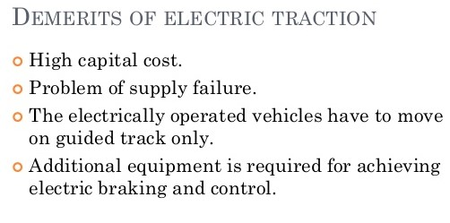

Slide 13
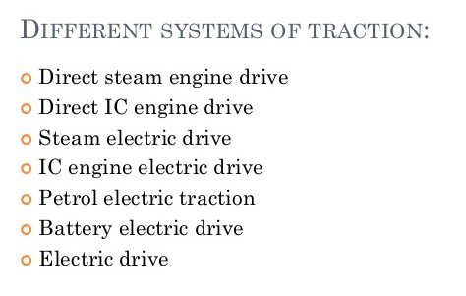

Slide 14
Direct steam engine drive
Steam engine is used to get the locomotive power where the steam is produced in a boiler by burning combustible material—usually coal, wood, or oil

Slide 15
Merits and demerits of direct steam engine drive
Merits
Demerits
Simplicity
Simplicity of connection between the cylinders and the driving wheels
Easy speed control
Locomotive and train unit is self contained unit therefore it is not tied to a route.
No interference to the communication lines
Capacity is very high in comparison to direct internal combustion engine drive and battery electric drive.
Initial investment is low in comparison to that of electric drive as no overhead structure, distribution system and substation is required.
Because of difficulty of installing a condenser on a locomotive efficiency is very poor (6 to 8 percent)
Operational dependability
Overload capacity is limited.
Adequate supply of feed water at regular intervals is required.
have to carry sufficient quantity of coal and water which correspondingly reduces the pay load that can be hauled.
More number of crew(one driver and two firing men) are required which increases the wages.
Owing to coal dust they are not a clean drive.
Owing to high center of gravity of steam locomotive speed is limited.

Slide 16
Direct internal combustion engine drive
IC engine is used to get the locomotive power.
Widely employed for road transport( buses, trucks, cars,etc).
Efficiency of IC engine at its normal speed is about 25%.

Slide 17
Merits and demerits of direct IC engine drive
Merits
Demerits
self contained unit therefore it is not tied to a route.
Initial investment required being only the cost of vehicle and garage, is very low.
Speed control and braking system employed is very simple.
Overload capacity is limited.
Its operation at any speed other than normal speed is uneconomical.
Speed control is possible only by employing a gear box.
Life of a propulsive equipment is much shorter than electrical equipment of a tram car or trolley bus.
Maintenance and running cost is higher .
Fuel oil has to be imported in the country like Nepal.
Less passenger capability than trolley bus.
No starting torque and must be started by some auxiliary means such as compressed air or electrically.

Slide 18
Steam electric drive
Steam turbine is used for driving a generator used for supplying current to electric motors.
Used for only experimental purposes.
Not put into general use because of some mechanical difficulties and complications.

Slide 19
IC engine electric drive
IC engine is used to drive the generator at a constant speed.
Reduction gear and gear box are eliminated.
Widely used in railway work.

Slide 20
Merits and demerits of IC engine electric drive
Merits
Demerits
Initial investment required is low as no overhead structure distribution system and equipment is required.
Can accommodate more passengers than steam engine vehicle
self contained unit therefore it is not tied to a route.
Can be put into service at any moment.
Overall efficiency is greater than that of steam locomotives
Overload capacity is limited as diesel engine cannot be overloaded.
Life of diesel engine is comparatively shorter.
Special cooling system is required to cool the diesel engine in addition to motor generator set.
Running and maintenance cost is higher .
Fuel oil has to be imported in the country like Nepal.
For same power output it is costlier than steam or electric locomotive because it carries diesel engine, main generator and traction motors. This also makes it more heavier than plain electric locomotive.
Regenerative braking cannot be used.

